Slide 1


E-Revive
Smart E-Waste Second-Life Platform
Transforming discarded electronics into second-life assets through automated valuation, refurbishment, parts recovery, and certified recycling.

Slide 2

1. The Problem Statement
A massive volume of functional or repairable electronic devices is dumped prematurely due to a lack of structured assessment and convenient disposal avenues.

Slide 3

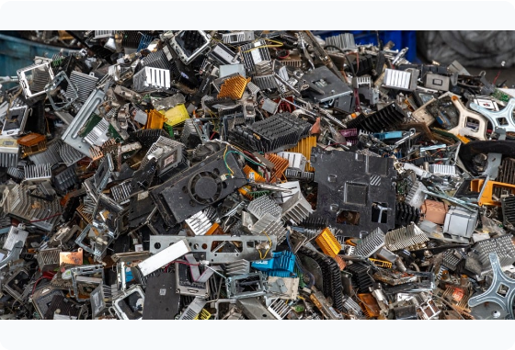
Discarded Value & Environmental Risk
Premature Disposal: Millions of smartphones, laptops, and chargers are thrown away even when minor repairs can restore full utility.
Lack of Consumer Awareness: Device owners don't know where to dispose of e-waste safely or how to estimate residual worth.
Lost Resource Value: Precious metals and reusable modules (RAM, displays, batteries) are permanently lost in landfills.
Informal Hazard: Unregulated disposal leads to severe toxic soil and water contamination.

Slide 4
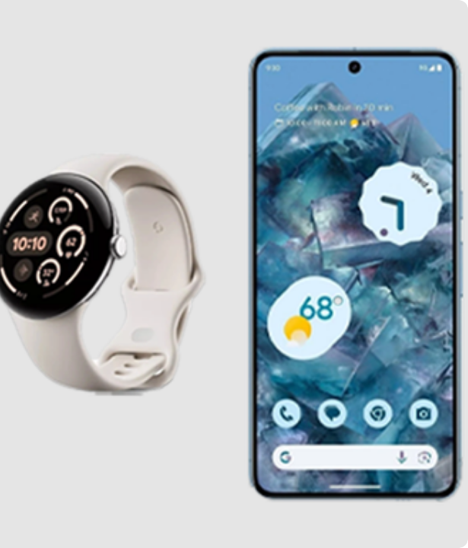

2. Proposed Idea: E-Revive
Smart Digital & Logistics Ecosystem
E-Revive is an intelligent digital platform that connects device owners with a circular second-life network.
Instead of routing all collected electronics straight to destruction, E-Revive assesses each device's condition to unlock its highest economic and functional value.
Core Objective:
Old Device → Smart Assessment → Repair/Reuse → Parts Harvest → Certified Recycling

Slide 5






4-Tier Device Classification
🟢 Direct Reuse
🔵 Refurbish
🟡 Parts Harvest
🔴 Eco Recycling
Device is in functional condition. Cleaned, data-wiped, and directed to secondary resale or donation channels.
Minor mechanical or battery repairs restore full utility, unlocking maximum resale margin for affordable tech buyers.
Non-repairable units are disassembled for usable displays, RAM modules, ICs, and copper wiring for repair markets.
Remaining hazardous materials & residue are safely handed over to CPCB-authorized metal extraction recyclers.

Slide 6








3. How the Solution Works
1. Register Device
2. Smart Valuation
3. Pickup & Triage
4. Optimal Route
User inputs specs, age, and condition via web or mobile app.
Algorithmic valuation generates immediate buyback offer.
Doorstep collection followed by diagnostic testing.
Device enters Reuse, Refurbishment, Harvesting, or Recycling.

Slide 7


4. Target Audience & Customers
Primary Consumers
B2B & Institutional
College Students: Seek affordable refurbished laptops and easy sell options.
IT Companies & Offices: Bulk e-waste retirement with compliance certificates.
Households: Convenient doorstep disposal for old phones, chargers, and gadgets.
Schools & Universities: Subscription-based bulk pickup & recycling drives.
Individual Professionals: Instant valuation and buyback rewards for upgrades.
Authorized Recyclers: Verified, steady supply of sorted e-waste residue.

Slide 8


5. What Makes E-Revive Novel?
TRADITIONAL E-WASTE FLOW
Collection Drive ➔ Direct Shredding & Recycling
(Recycling is the 1st option — destroys working components)
E-REVIVE CIRCULAR PARADIGM
Assess ➔ Reuse ➔ Refurbish ➔ Parts Harvest ➔ Recycle
(Recycling is the FINAL option — maximizes economic & component life)

Slide 9



6. Diversified Monetization Streams
1. Refurbished Sales
2. Parts Marketplace
3. Recycler Fee
4. Enterprise B2B
Buy used laptops (~₹3,000), repair (~₹1,000), sell (~₹5,000). High gross margins per restored device.
Selling extracted functional RAM, displays, adapters, and circuit boards to repair shops.
Earning collection and sorting commissions from CPCB-certified scrap processors.
Monthly compliance subscriptions for corporate e-waste auditing & disposal reports.

Slide 10
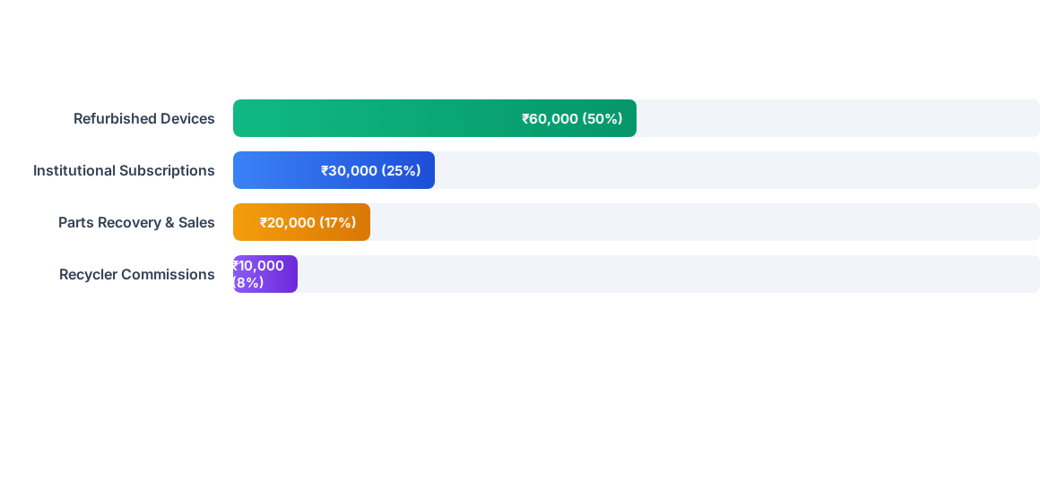
7. Financial Projections (~300 Units/Mo)
Estimated Gross Revenue: ~₹1,20,000/month. Estimated initial net profitability ranges between ₹30,000 – ₹50,000/month after logistics, testing, and operational expenses.

Slide 11
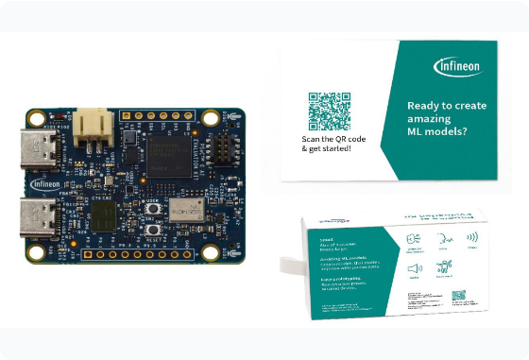

8. Technology Stack & AI Integration
Frontend: Responsive UI built with React.js, HTML5, and Tailwind CSS.
Backend & DB: Node.js / Express microservices backed by MongoDB.
AI/ML Valuation Engine: Predicts repairability probability and estimates market resale price based on specs, battery wear, and age.
ML Yield Prediction: ₹4,500 Resale Value

Slide 12

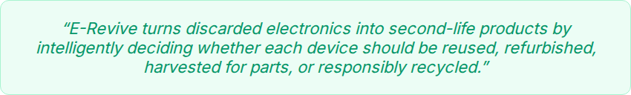
Thank You!
Questions & Discussion
www.e-revive.platform contact@e-revive.org

Slide 13




Image Sources
https://media.baumpub.com/files/slides/locale_image/full/0215/53637_en_a595e_56094_computer-parts-waste-scrape-stock-image.jpg
Source: www.recyclingproductnews.com
https://i.ebayimg.com/thumbs/images/g/S~4AAeSw9Hxqcmni/s-l640.png
Source: www.ebay.com
https://greentekreman.com/wp-content/uploads/2021/07/Sustainable-development.png
Source: greentekreman.com
https://developer.imagimob.com/Images/evaluation-kit/pic-1.png
Source: developer.imagimob.com

